Slide 1
Chapter 7: Module 14: Routing Concepts
Switching, Routing, and Wireless Essentials v7.0
(SRWE)
Notes:
Cisco Networking Academy Program
Switching, Routing, and Wireless Essentials v7.0 (SRWE)
Module 14: Routing Concepts

Slide 2
Module Objectives
Module Title: Routing Concepts
Module Objective: Explain how routers use information in packets to make forwarding decisions.
Topic Title | Topic Objective
Path Determination | Explain how routers determine the best path.
Packet Forwarding | Explain how routers forward packets to the destination.
Basic Router Configuration Review | Configure basic settings on a router.
IP Routing Table | Describe the structure of a routing table.
Static and Dynamic Routing | Compare static and dynamic routing concepts.
Notes:
‹#›
14- Routing Concepts
14.0 – Introduction
14.0.2 - What will I learn to do in this module?

Slide 3
14.1 Path Determination
Notes:
14 - Routing Concepts
14.1 - Path Determination

Slide 4
Path Determination Two Functions of a Router
When a router receives an IP packet on one interface, it determines which interface to use to forward the packet to the destination. This is known as routing.
The interface that the router uses to forward the packet may be the final destination, or it may be a network connected to another router that is used to reach the destination network. Each network that a router connects to typically requires a separate interface, but this may not always be the case.
The primary functions of a router are to determine the best path to forward packets based on the information in its routing table, and to forward packets toward their destination.
Notes:
14 - Routing Concepts
14.1 - Path Determination
14.1.1 - Two Functions of a Router

Slide 5
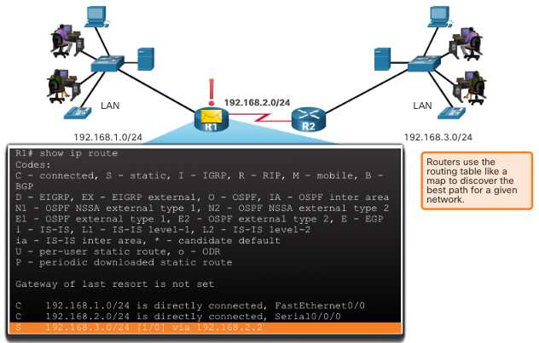
Path Determination Router Functions Example
The router uses its IP routing table to determine which path (route) to use to forward a packet.
R1 and R2 will use their respective IP routing tables to first determine the best path, and then forward the packet.
Notes:
14 - Routing Concepts
14.1 - Path Determination
14.1.2 - Router Functions Example

Slide 6
Path Determination Best Path Equals Longest Match
The best path in the routing table is also known as the longest match.
The routing table contains route entries consisting of a prefix (network address) and prefix length. For there to be a match between the destination IP address of a packet and a route in the routing table, a minimum number of far-left bits must match between the IP address of the packet and the route in the routing table. The prefix length of the route in the routing table is used to determine the minimum number of far-left bits that must match.
The longest match is the route in the routing table that has the greatest number of far-left matching bits with the destination IP address of the packet. The longest match is always the preferred route.
Note: The term prefix length will be used to refer to the network portion of both IPv4 and IPv6 addresses.
Notes:
14 - Routing Concepts
14.1 - Path Determination
14.1.3 - Best Path Equals Longest Match

Slide 7
Path Determination IPv4 Longest Match Example
In the table, an IPv4 packet has the destination IPv4 address 172.16.0.10. The router has three route entries in its IPv4 routing table that match this packet: 172.16.0.0/12, 172.16.0.0/18, and 172.16.0.0/26. Of the three routes, 172.16.0.0/26 has the longest match and would be chosen to forward the packet. For any of these routes to be considered a match there must be at least the number of matching bits indicated by the subnet mask of the route.
Destination IPv4 Address |  | Address in Binary
172.16.0.10 |  | 10101100.00010000.00000000.00001010
Route Entry | Prefix/Prefix Length | Address in Binary
1 | 172.16.0.0/12 | 10101100.00010000.00000000.00001010
2 | 172.16.0.0/18 | 10101100.00010000.00000000.00001010
3 | 172.16.0.10 172.16.0.0/26 | 10101100.00010000.00000000.00001010 10101100.00010000.00000000.00000000
Notes:
14 - Routing Concepts
14.1 - Path Determination
14.1.4 - IPv4 Longest Match Example

Slide 8
14.1 Path Determination
Notes:
14 - Routing Concepts
14.1 - Path Determination

Slide 9
Path Determination Build the Routing Table
Directly Connected Networks: Added to the routing table when a local interface is configured with an IP address and subnet mask (prefix length) and is active (up and up).
Remote Networks: Networks that are not directly connected to the router. Routers learn about remote networks in two ways:
Static routes - Added to the routing table when a route is manually configured.
Dynamic routing protocols - Added to the routing table when routing protocols dynamically learn about the remote network.
Default Route: Specifies a next-hop router to use when the routing table does not contain a specific route that matches the destination IP address. The default route can be entered manually as a static route, or learned automatically from a dynamic routing protocol.
A default route has a /0 prefix length. This means that no bits need to match the destination IP address for this route entry to be used. If there are no routes with a match longer than 0 bits, the default route is used to forward the packet. The default route is sometimes referred to as a gateway of last resort.
ip route 0.0.0.0 0.0.0.0 s0/0/0
Notes:
14 - Routing Concepts
14.1 - Path Determination
14.1.6 - Build the Routing Table
14.1.7 - Check Your Understanding - Path Determination

Slide 10
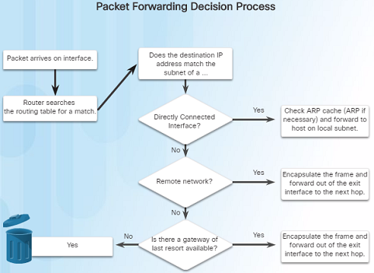
Path Determination Routing Decisions
The primary function of a router is to determine the best path to send packets.
A routing table search results in one of three path determinations:
Directly connected network – If the destination IP address belongs to a network that is directly connected to the router, the packet is forwarded out of that interface.
Remote network – If the destination IP address of the packet belongs to a remote network, the packet is forwarded to another router.
No route determined – If the destination IP address does not belong to a connected network or is in the routing table, the packet is sent to Gateway of Last Resort.
Notes:
1.2 – Routing Decisions
1.2.2 – Path Determination
1.2.2.1 – Routing Decisions

Slide 11
Path Determination Routing Decisions
Notes:
1.2 – Routing Decisions
1.2.2 – Path Determination
1.2.2.1 – Routing Decisions

Slide 12
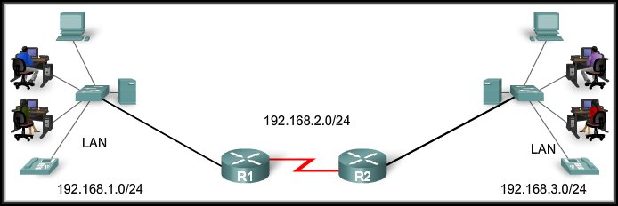
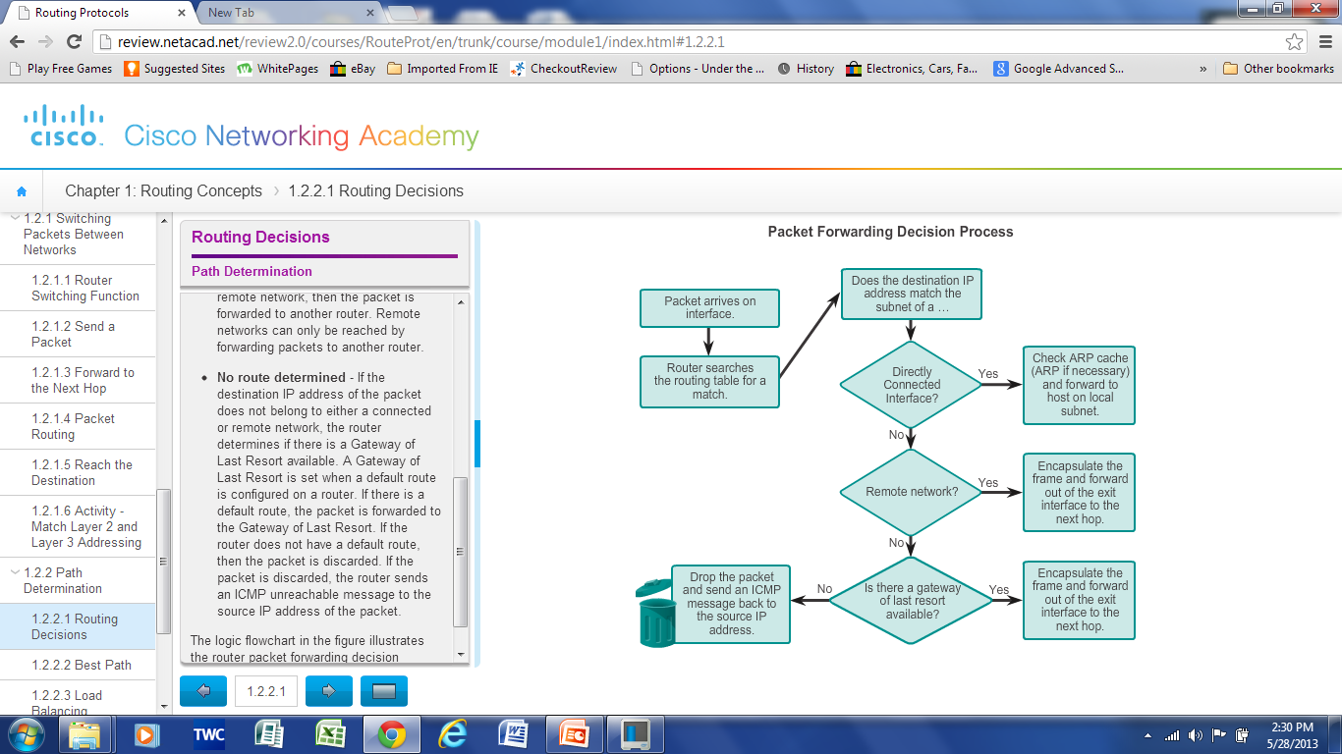
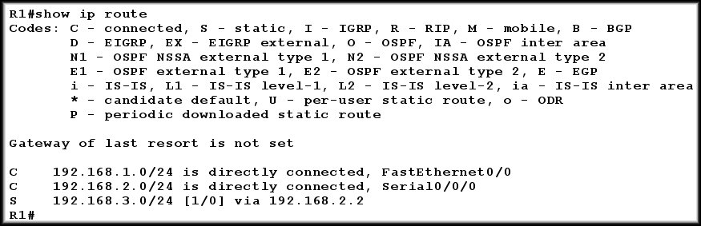
Source IP | Destination IP
192.168.1.101 | 192.168.3.22

Slide 13
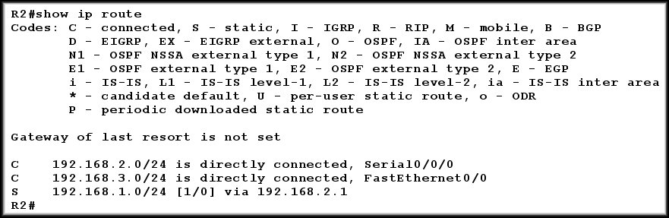
Source IP | Destination IP
192.168.1.101 | 192.168.3.22

Slide 14
Source IP | Destination IP
192.168.1.101 | 192.168.5.5
DROP!
0.0.0.0 0.0.0.0 s0/0/0 – not available

Slide 15
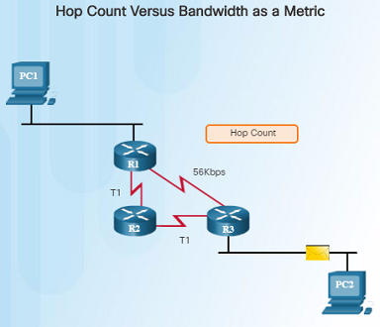
Path Determination Best Path
Determining the best path to a destination network involves the evaluation of multiple paths and selecting the optimum or shortest path to reach that network.
The best path is selected based on the metric or value that is used by the routing protocol.
The best path to a network is the path with the lowest metric. A metric is a value that is used to measure the distance to a given network.
Each dynamic routing protocols has their own rules and metrics to build and update routing tables. For example:
Routing Information Protocol (RIP) – Hop count
Open Shortest Path First (OSPF) – Cisco’s cost based cumulative bandwidth from source to destination
Enhanced Interior Gateway Routing Protocol (EIGRP) – Bandwidth, delay, load, reliability
R1 to R3 is the prefer path – best path
Notes:
1.2 – Routing Decisions
1.2.2 – Path Determination
1.2.2.2 – Best Path

Slide 16
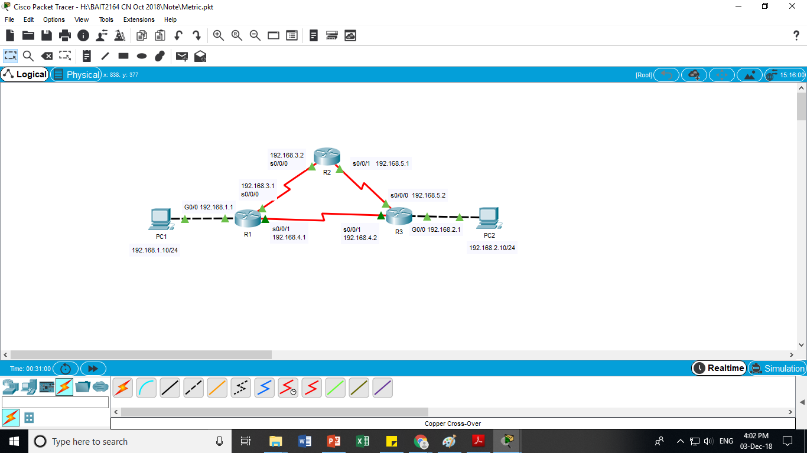
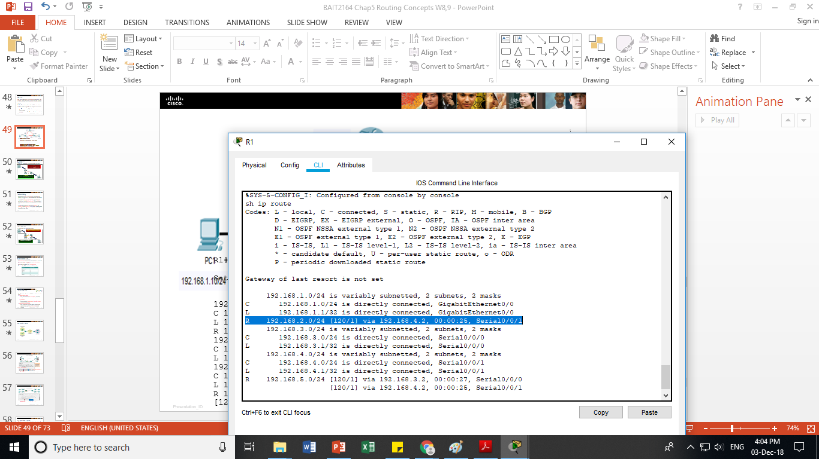
All routers had been configured with RIP
2 paths to reach 192.168.2.0
R1 choose the path with lowest metric (192.168.2.0, s0/0/1)
Path 2 – 2 hop counts
Path 1 – 1 hop count
R1 Routing Table [ AD / Metric ]

Slide 17
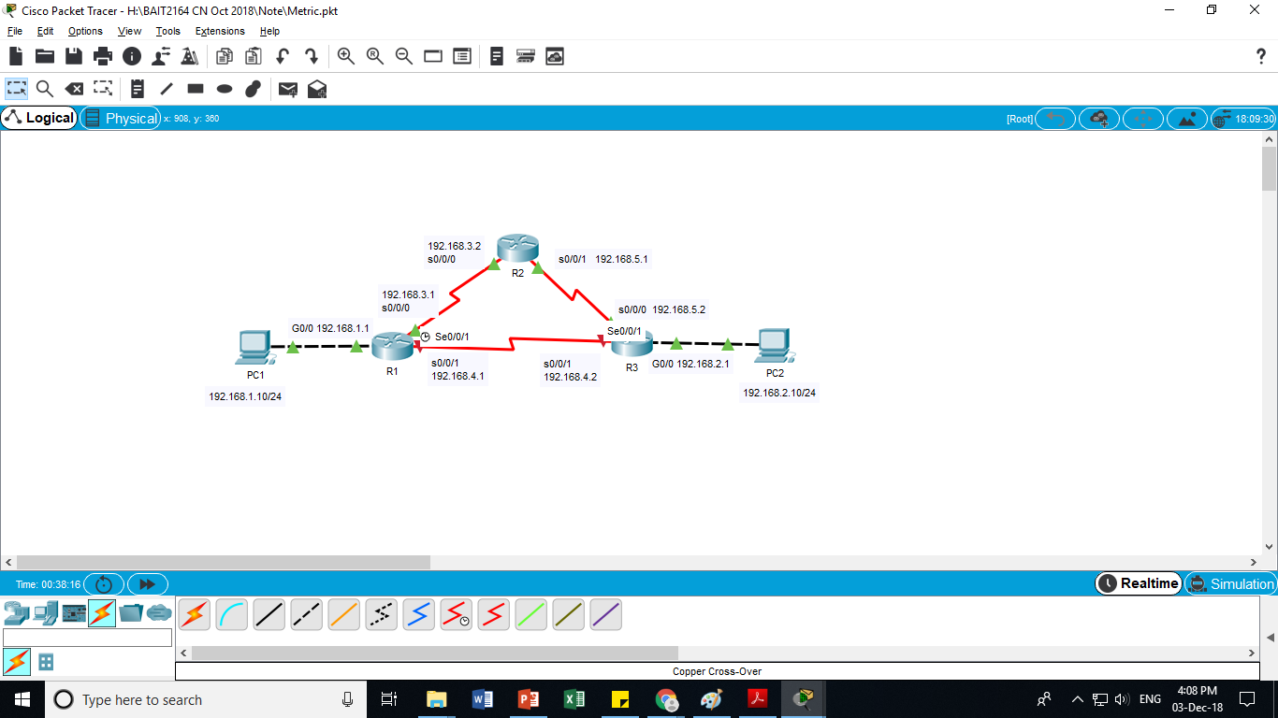
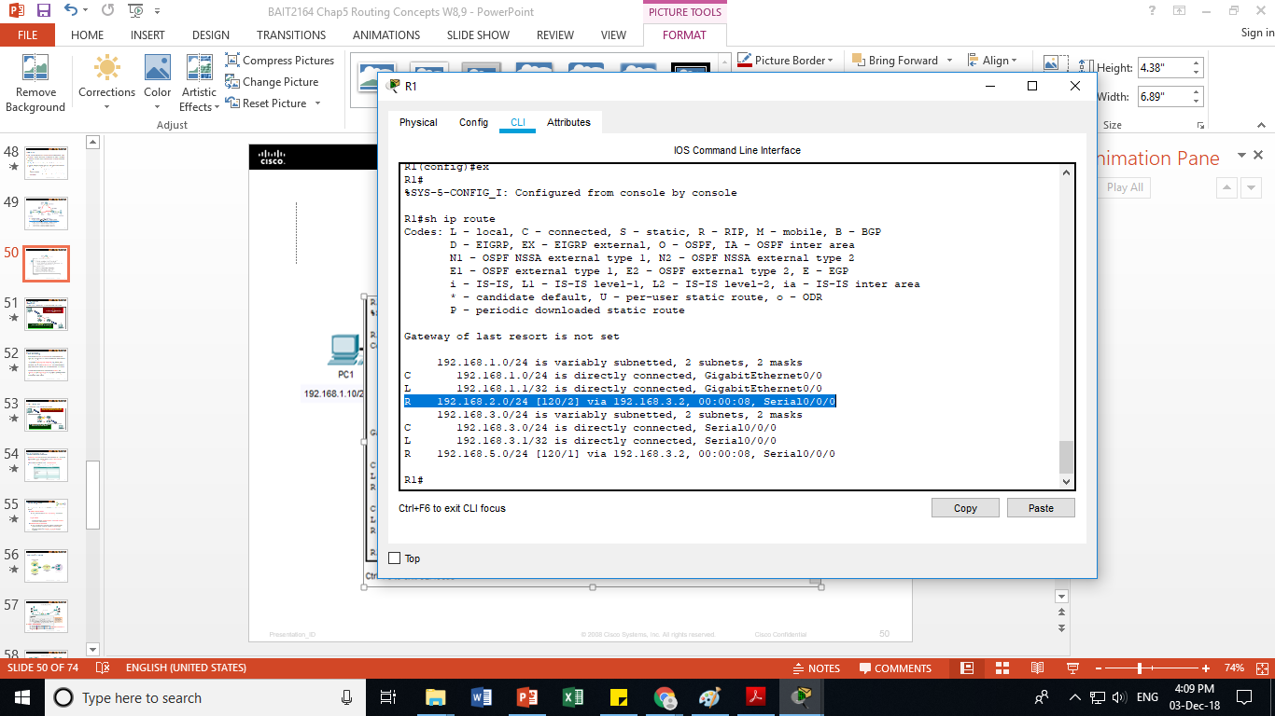
All routers had been configured with RIP
R1 s0/0/1 is shutdown.
Only 1 path to reach 192.168.2.0
R1 choose the path with lowest metric (192.168.2.0 ,s0/0/0)
S0/0/0 – 2 hop counts

Slide 18
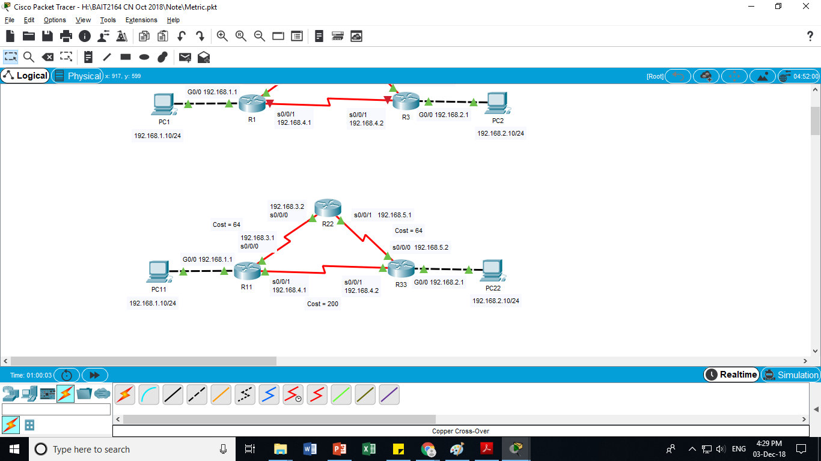
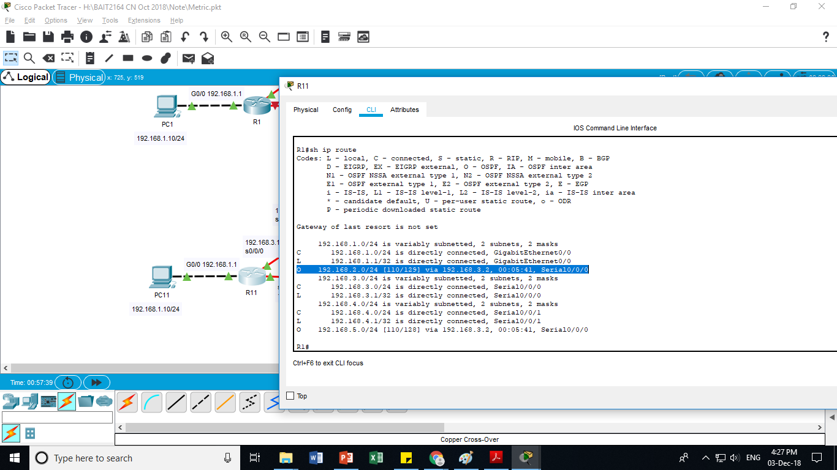
All routers had been configured with OSPF
2 paths to reach 192.168.2.0
R1 choose the path with lowest metric (192.168.2.0, s0/0/0)
Path 2
= 64 +64+ 1
=129
Path 1
Cost = 1

Slide 19

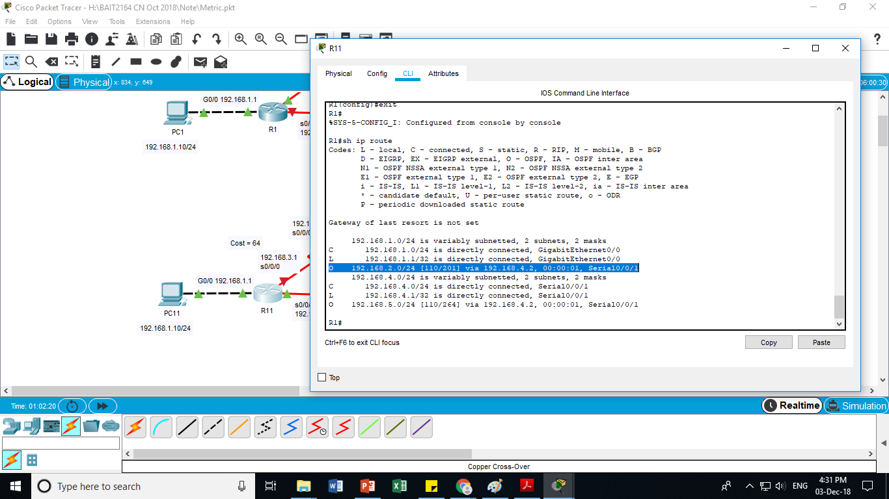
All routers had been configured with OSPF
R1 s0/0/0 is shutdown.
Only 1 path to reach 192.168.2.0
R1 choose the path with lowest metric (192.168.2.0 , s0/0/1)
Path 1 = 200 + 1 =201

Slide 20
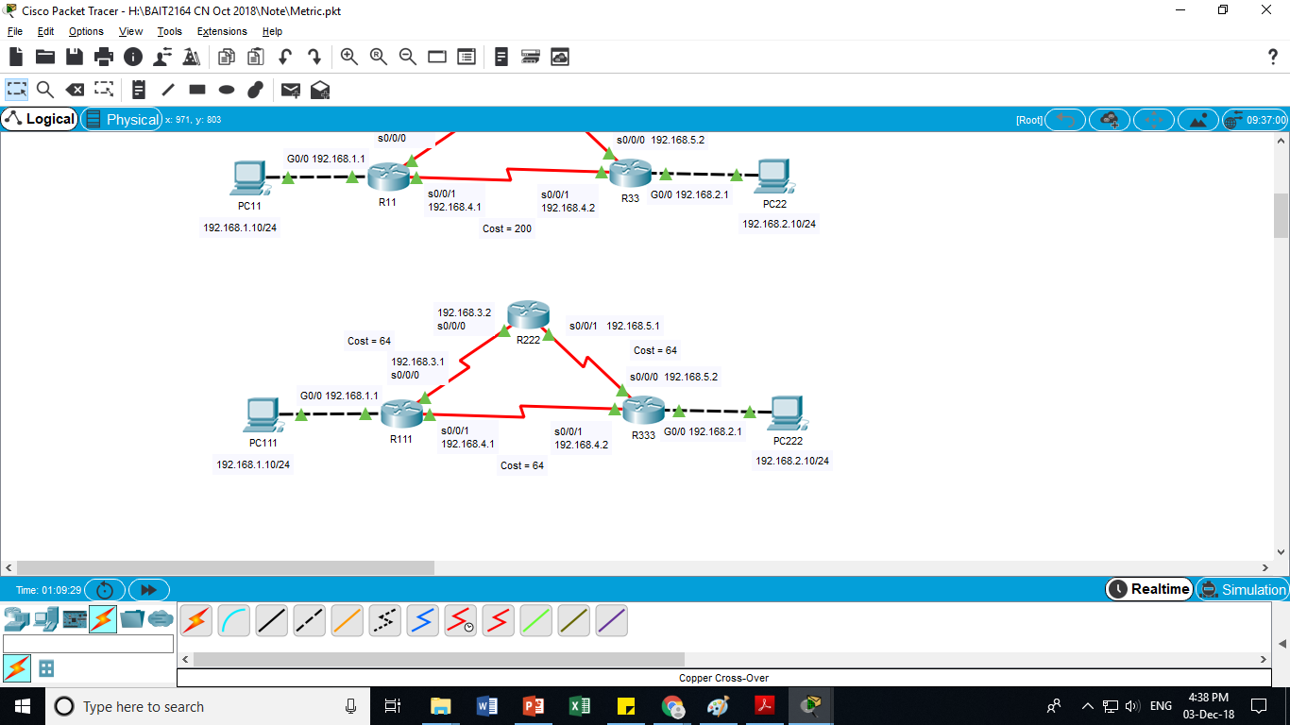
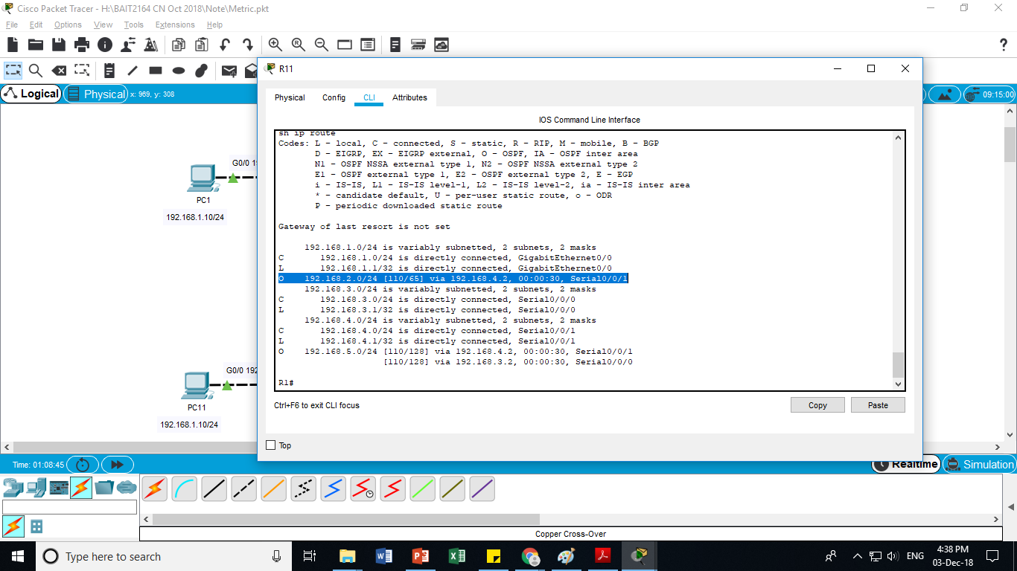
All routers had been configured with OSPF
2 paths to reach 192.168.2.0
R1 choose the path with lowest metric (path 1, 192.168.2.0, s0/0/1)
Path 2
= 64 +64+ 1
=129
Path 1 = 64+ 1 = 65

Slide 21
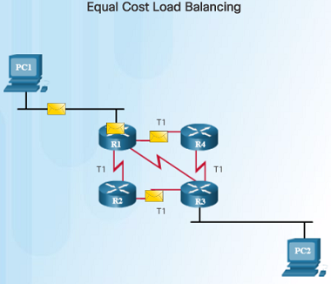
Path Determination Load Balancing
If a router has two or more paths with identical metrics to the same destination network, the router will forward the packets using both paths equally.
The routing table contains a single destination network, but has multiple exit interfaces – one for each equal cost path. This is referred to as equal cost load balancing.
If configured correctly, load balancing can increase the effectiveness and performance of the network.
Equal cost load balancing can be configured to use both dynamic routing protocols and static routes.
EIGRP supports unequal cost load balancing.
Notes:
1.2 – Routing Decisions
1.2.2 – Path Determination
1.2.2.3 – Load Balancing

Slide 22
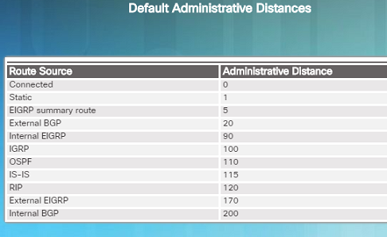
Path Determination Administrative Distance
If a router has multiple routing protocols configured and static routes, it is possible that the routing table might have more than one route source for the same destination network.
Each routing protocol might prefer a different path to reach the same destination. How does the router know which path to choose?
The Cisco IOS uses what is known as the administrative distance (AD) to determine which route to install in the routing table.
The AD represents the “trustworthiness” of the route. The lower the AD, the more trustworthy.
Which route source is more trustworthy, Internal EIGRP or OSPF?
Notes:
1.2 – Routing Decisions
1.2.2 – Path Determination
1.2.2.4 – Administrative Distance

Slide 23
All routers had been configured with OSPF and RIP
Metrics (cost and hop count) are not comparable
Choose the path based on AD. RIP – 120, OSPF - 110
R1 choose the path with lower AD (OSPF – 110)

Slide 24
IP Routing Table Administrative Distance
A route entry for a specific network address (prefix and prefix length) can only appear once in the routing table. However, it is possible that the routing table learns about the same network address from more than one routing source. Except for very specific circumstances, only one dynamic routing protocol should be implemented on a router. Each routing protocol may decide on a different path to reach the destination based on the metric of that routing protocol.
This raises a few questions, such as the following:
How does the router know which source to use?
Which route should it install in the routing table?
Cisco IOS uses what is known as the administrative distance (AD) to determine the route to install into the IP routing table. The AD represents the "trustworthiness" of the route. The lower the AD, the more trustworthy the route source.
Notes:
14 - Routing Concepts
14.4 - IP Routing Table
14.4.12 - Administrative Distance

Slide 25
IP Routing Table Administrative Distance (Cont.)
The table lists various routing protocols and their associated ADs.
Route Source | Administrative Distance
Directly connected | 0
Static route | 1
EIGRP summary route | 5
External BGP | 20
Internal EIGRP | 90
OSPF | 110
IS-IS | 115
RIP | 120
External EIGRP | 170
Internal BGP | 200
Notes:
14 - Routing Concepts
14.4 - IP Routing Table
14.4.12 - Administrative Distance (Cont.)
14.4.13 - Check Your Understanding - IP Routing Table

Slide 26
2.0 EIGRP
Notes:
6 - EIGRP
6.1 – EIGRP Characteristics

Slide 27
Chapter 2 - Sections & Objectives
2.1 EIGRP Characteristics
Explain the features and characteristics of EIGRP.
Describe the basic features of EIGRP.
Describe the types of packets used to establish and maintain an EIGRP neighbor adjacency.
Describe the encapsulation of an EIGRP messages.
2.2 Implement EIGRP for IPv4
Implement EIGRP for IPv4 in a small to medium-sized business network.
Configure EIGRP for IPv4 in a small routed network.
Verify EIGRP for IPv4 operation in a small routed network.
Notes:
‹#›
Cisco Networking Academy Program
Scaling Networks v6.0
Chapter 6: EIGRP

Slide 28
Chapter 2 - Sections & Objectives (Cont.)
2.3 EIGRP Operation
Explain how EIGRP operates in a small to medium-sized business network.
Explain how EIGRP forms neighbor relationships.
Explain the metrics used by EIGRP.
Explain how DUAL operates and uses the topology table.
Describe events that trigger EIGRP updates.
Notes:
‹#›
Cisco Networking Academy Program
Scaling Networks v6.0
Chapter 6: EIGRP

Slide 29
2.1 EIGRP Characteristics
Notes:
6 - EIGRP
6.1 – EIGRP Characteristics

Slide 30
EIGRP Characteristics EIGRP Basic Features
Enhanced IGRP is a Cisco- proprietary distance-vector routing protocol released in 1992.
EIGRP was created as a classless version of IGRP.
Ideal choice for large, multiprotocol networks built primarily on Cisco routers.
EIGRP Feature | Description
Diffusing Update Algorithm (DUAL) | EIGRP uses DUAL as its routing algorithm. DUAL guarantees loop-free and backup paths throughout the routing domain.
Establishing Neighbor Adjacencies | EIGRP establishes relationships with directly connected EIGRP routers. Adjacencies are used to track the status of these neighbors.
Reliable Transport Protocol | EIGRP RTP provides delivery of EIGRP packets to neighbors. RTP and neighbor adjacencies are used by DUAL.
Partial and Bounded updates | Instead of periodic updates, EIGRP sends partial triggered updates when a path or metric changes. Only those routers that require the information are updated minimizing bandwidth use.
Equal and Unequal Cost Load Balancing | EIGRP supports equal cost load balancing and unequal cost load balancing, which allows administrators to better distribute traffic flow in their networks.
Notes:
6.1 - EIGRP Characteristics
6.1.1 - EIGRP Basic Features
6.1.1.1 – Features of EIGRP

Slide 31
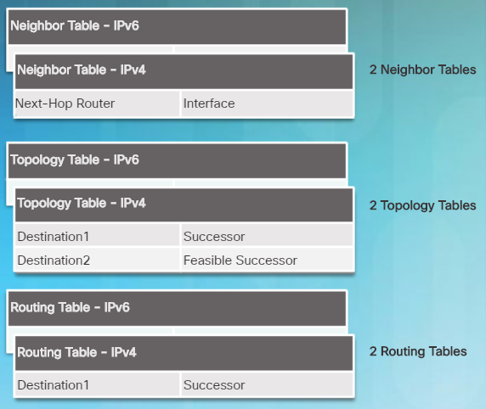
EIGRP Characteristics EIGRP Basic Features
EIGRP uses protocol-dependent modules (PDMs) to support different protocols such as IPv4, IPv6, and legacy protocols IPX and AppleTalk.
EIGRP maintains individual tables for each routed protocol.
PDMs are responsible for:
Maintaining EIGRP neighbor and topology tables
Computing the metric using DUAL
Interfacing DUAL and routing table
Implementing filtering and access lists
Performing redistribution with other routing protocols
Notes:
6.1 - EIGRP Characteristics
6.1.1 - EIGRP Basic Features
6.1.1.2 – Protocol Dependent Modules

Slide 32
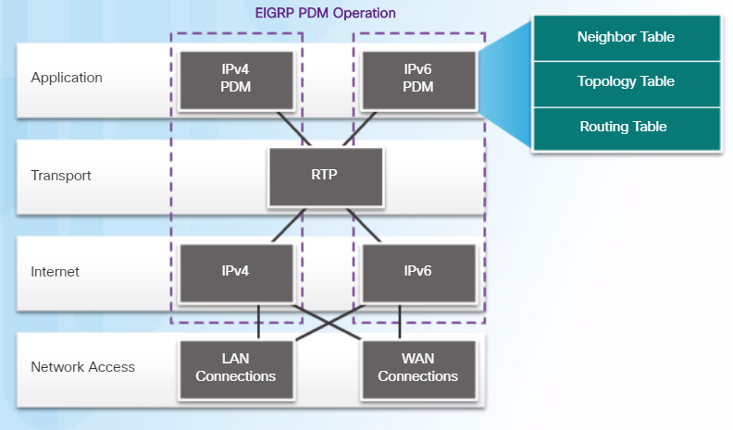
EIGRP Characteristics EIGRP Basic Features
RTP is the EIGRP Transport layer protocol used for the delivery and reception of EIGRP packets.
Not all RTP packets are sent reliably.
Reliable packets require explicit acknowledgement from destination
Update, Query, Reply
Unreliable packets do not require acknowledgement from destination
Hello, ACK
Notes:
6.1 - EIGRP Characteristics
6.1.1 - EIGRP Basic Features
6.1.1.3 – Reliable Transport Protocol

Slide 33
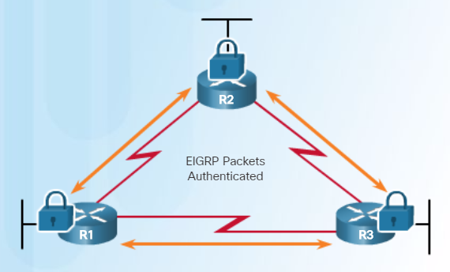
EIGRP Characteristics EIGRP Basic Features
EIGRP supports authentication and is recommended.
EIGRP authentication ensures that routers only accept routing information from other routers that have been configured with the same password or authentication information.
Note:
Authentication does not encrypt the EIGRP routing updates.
Notes:
6.1 - EIGRP Characteristics
6.1.1 - EIGRP Basic Features
6.1.1.4 – Authentication

Slide 34
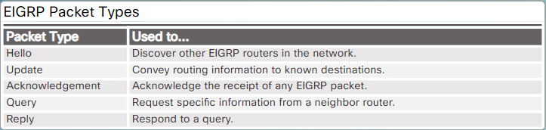
EIGRP Characteristics EIGRP Packet Types
IP EIGRP relies on 5 types of packets to maintain its various tables and establish complex relationships with neighbor routers.
Notes:
6.1 - EIGRP Characteristics
6.1.2 - EIGRP Packet Types
6.1.2.1 – EIGRP Packet Types

Slide 35
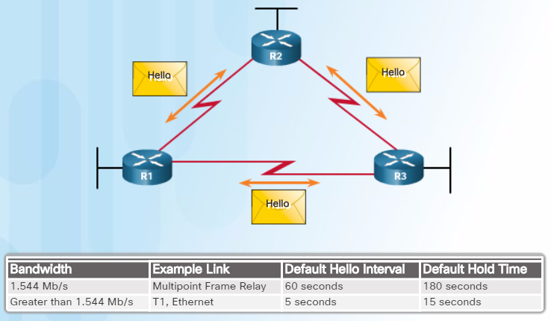
EIGRP Characteristics EIGRP Packet Types
Hello packets are used to discover & form adjacencies with neighbors.
On hearing Hellos, a router creates a neighbor table and the continued receipt of Hellos maintains the table.
Hello packets are always sent unreliably.
Therefore Hello packets do not require acknowledgment.
EIGRP uses multicast and unicast rather than broadcast.
As a result, end stations are unaffected by routing updates or queries.
The EIGRP multicast IPv4 address is 224.0.0.10
The EIGRP multicast IPv6 address is FF02::A.
Notes:
6.1 - EIGRP Characteristics
6.1.2 - EIGRP Packet Types
6.1.2.2 – EIGRP Hello Packets

Slide 36
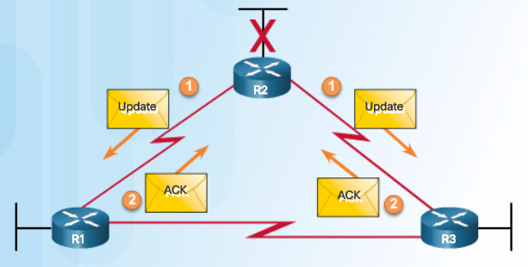
EIGRP Characteristics EIGRP Packet Types
EIGRP Update packets are used to propagate routing information.
Sent to initially exchange topology information or topology change.
EIGRP updates only contain needed routing information and are unicast to routers that require it.
Update packets are sent reliably and therefore requires acknowledgements.
Acknowledgements packets are “dataless” Hello packets used to indicate receipt of any EIGRP packet during a "reliable" (i.e., RTP) exchange.
Used to acknowledge the receipt of Update packets, Query packets, and Reply packets.
Notes:
6.1 - EIGRP Characteristics
6.1.2 - EIGRP Packet Types
6.1.2.3 – EIGRP Update and Acknowledge Packets

Slide 37
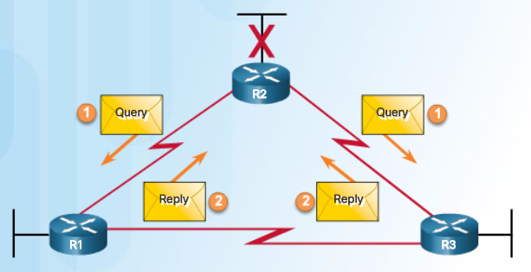
EIGRP Characteristics EIGRP Packet Types
Query and reply packets are used by DUAL when searching for networks.
They both use reliable delivery and therefore require acknowledgement.
Queries can use multicast or unicast, whereas Replies are always sent as unicast.
Notes:
6.1 - EIGRP Characteristics
6.1.2 - EIGRP Packet Types
6.1.2.4 – EIGRP Query and Reply Packets

Slide 38
2.2 Implement EIGRP for IPv4
Notes:
6 - EIGRP
6.2 – Implement EIGRP for IPv4

Slide 39
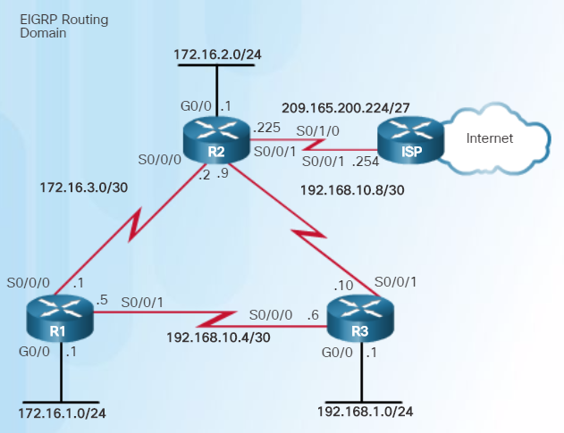
Implement EIGRP for IPv4 Configure EIGRP with IPv4
The routers in the topology have a starting configuration that includes addresses on the interfaces. There is currently no static routing or dynamic routing configured on any of the routers.
Notes:
6.2 – Implement EIGRP for IPv4
6.2.1 – Configure EIGRP with IPv4
6.2.1.1 – EIGRP Network Topology

Slide 40
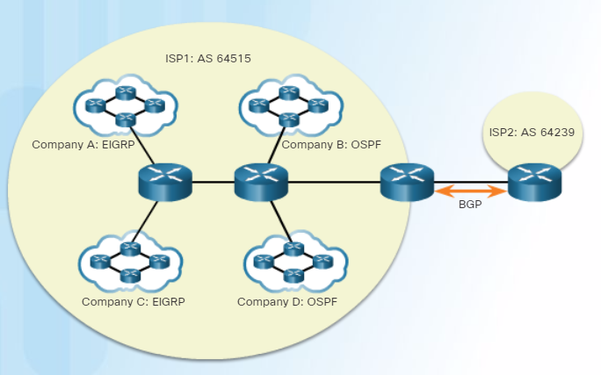
Implement EIGRP for IPv4 Configure EIGRP with IPv4
An Autonomous System (AS) is a collection of networks under the control of a single authority (reference RFC 1930).
AS numbers are needed to exchange routes between AS.
AS numbers are managed by IANA and assigned by RIRs to ISPs, Internet Backbone providers, and institutions connecting to other institutions using AS numbers.
AS numbers are usually 16-bit numbers, ranging from 0 to 65535.
Since 2007, AS numbers can now be 32 bits, therefore increasing the number of AS numbers to over 4 billion.
Notes:
6.2 – Implement EIGRP for IPv4
6.2.1 – Configure EIGRP with IPv4
6.2.1.2 – Autonomous System Numbers

Slide 41
Implement EIGRP for IPv4 Configure EIGRP with IPv4
To configure EIGRP, use the router eigrp AS-# command.
The AS-# functions as a process ID.
The AS number used for EIGRP configuration is only significant to the EIGRP routing domain.
All routers in the EIGRP routing domain must use the same AS number (process ID number).
Note:
Do NOT configure multiple instances of EIGRP on the same router.
Notes:
6.2 – Implement EIGRP for IPv4
6.2.1 – Configure EIGRP with IPv4
6.2.1.3 – The router eigrp Command

Slide 42
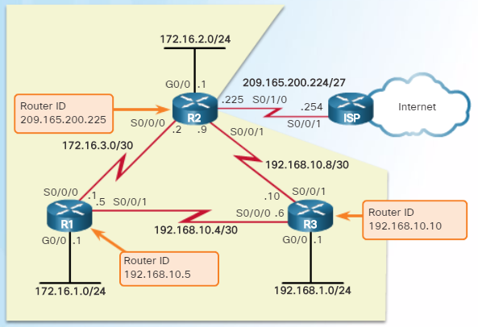
Implement EIGRP for IPv4 Configure EIGRP with IPv4
The EIGRP router ID is used to uniquely identify each router in the EIGRP routing domain.
Routers use the following three criteria to determine its router ID:
Use the address configured with the eigrp router-id ipv4-address router config command.
If the router ID is not configured, choose the highest IPv4 address of any of its loopback interfaces.
If no loopback interfaces are configured, choose the highest active IPv4 address of any of its physical interfaces.
Notes:
6.2 – Implement EIGRP for IPv4
6.2.1 – Configure EIGRP with IPv4
6.2.1.4 – EIGRP Router ID

Slide 43


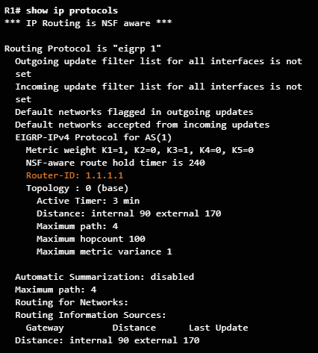
Implement EIGRP for IPv4 Configure EIGRP with IPv4
Notes:
6.2 – Implement EIGRP for IPv4
6.2.1 – Configure EIGRP with IPv4
6.2.1.5 – Configuring the EIGRP Router ID

Slide 44
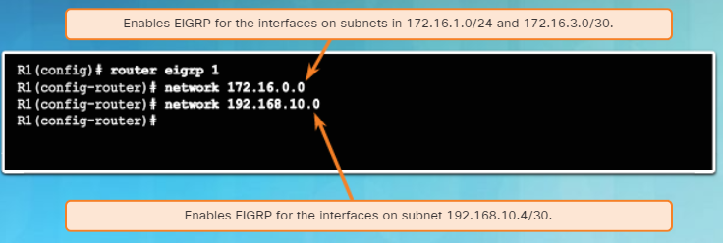
Implement EIGRP for IPv4 Configure EIGRP with IPv4
Use the network network-number [wildcard-mask] router config command to enable and advertise a network in EIGRP.
It enables the interfaces configured for that network address to begin transmitting & receiving EIGRP updates
Includes network or subnet in EIGRP updates
Notes:
6.2 – Implement EIGRP for IPv4
6.2.1 – Configure EIGRP with IPv4
6.2.1.6 –The network Command

Slide 45
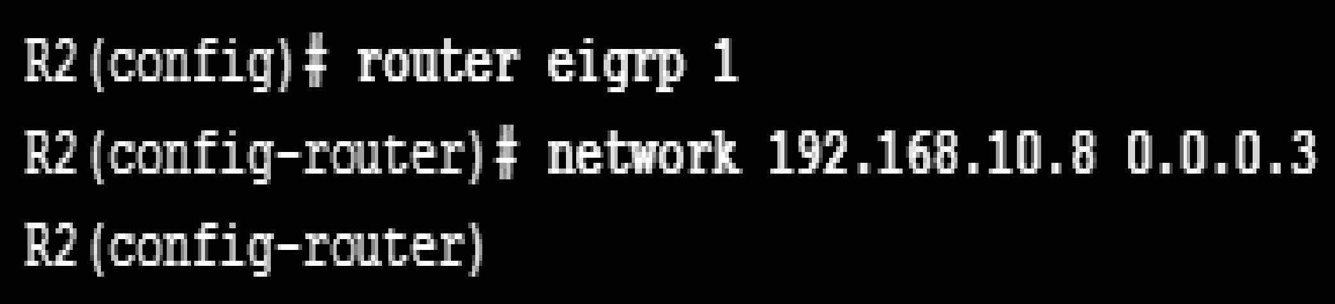
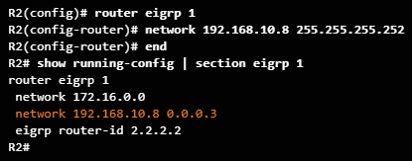
Implement EIGRP for IPv4 Configure EIGRP with IPv4
A wildcard mask is similar to a subnet mask but is calculated by subtracting a SNM from 255.255.255.255.
For example, if the SNM is 255.255.255.252:
255.255.255.255
- 255.255.255.252
0. 0. 0. 3 Wildcard mask
EIGRP also automatically converts a subnet mask to its wildcard mask equivalent.
E.g., entering 192.168.10.8 255.255.255.252 automatically converts to 192.168.10.8 0.0.0.3
s
Notes:
6.2 – Implement EIGRP for IPv4
6.2.1 – Configure EIGRP with IPv4
6.2.1.7 –The network Command and Wildcard Mask

Slide 46

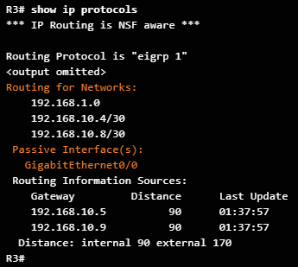
Implement EIGRP for IPv4 Configure EIGRP with IPv4
Passive interfaces prevent EIGRP updates out a specified router interface.
Set a particular interface or all router interfaces to passive.
The default option sets all router interfaces to passive.
Prevents neighbor relationships from being established.
Routing updates from a neighbor are ignored.
Router(config-router)#
passive-interface type number [default]
Notes:
6.2 – Implement EIGRP for IPv4
6.2.1 – Configure EIGRP with IPv4
6.2.1.8 –Passive Interface

Slide 47
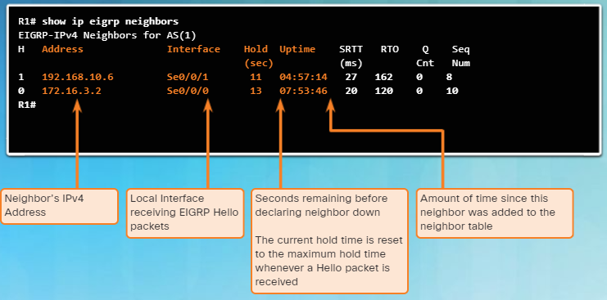
Implement EIGRP for IPv4 Verify EIGRP with IPv4
Use the show ip eigrp neighbors command to view the neighbor table and verify that EIGRP has established an adjacency with its neighbors.
The output displays a list of each adjacent neighbor.
Notes:
6.2 – Implement EIGRP for IPv4
6.2.2 – Verify EIGRP with IPv4
6.2.2.1 –Verifying EIGRP: Examining Neighbors

Slide 48
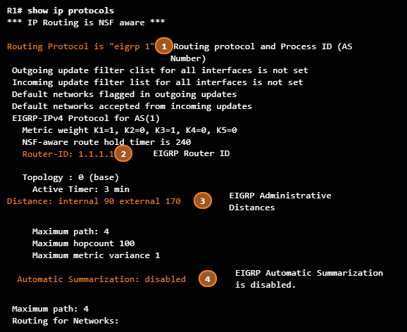
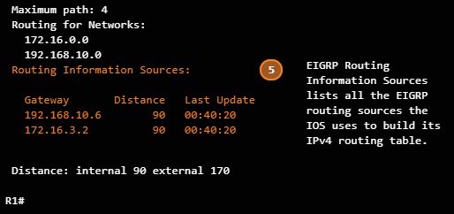
Implement EIGRP for IPv4 Verify EIGRP with IPv4
The show ip protocols command is useful to identify the parameters and other information about the current state of any active IPv4 routing protocol processes configured on the router.
For example, in the command output in the figure:
EIGRP is an active dynamic routing protocol on R1 configured with the autonomous system number 1.
The EIGRP router ID of R1 is 1.1.1.1.
The EIGRP administrative distances on R1 are internal AD of 90 and external of 170 (default values).
By default, EIGRP does not automatically summarize networks. Subnets are included in the routing updates.
The EIGRP neighbor adjacencies R1 has with other routers used to receive EIGRP routing updates.
Notes:
6.2 – Implement EIGRP for IPv4
6.2.2 – Verify EIGRP with IPv4
6.2.2.2 –Verifying EIGRP: show ip protocols Command

Slide 49
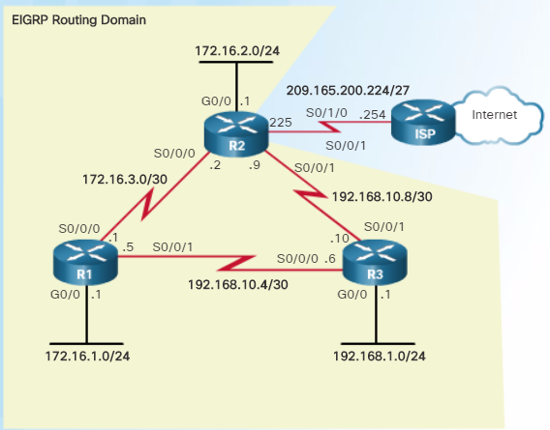
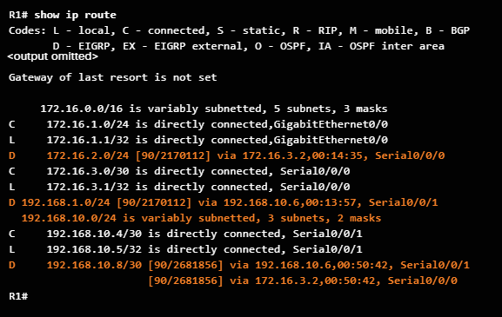
Implement EIGRP for IPv4 Verify EIGRP with IPv4
Notes:
6.2 – Implement EIGRP for IPv4
6.2.2 – Verify EIGRP with IPv4
6.2.2.3 –Verifying EIGRP: Examine the IPv4 Routing Table

Slide 50
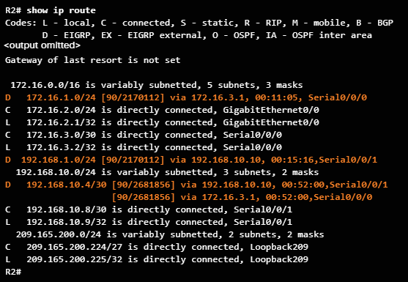
Implement EIGRP for IPv4 Verify EIGRP with IPv4
Notes:
6.2 – Implement EIGRP for IPv4
6.2.2 – Verify EIGRP with IPv4
6.2.2.3 –Verifying EIGRP: Examine the IPv4 Routing Table

Slide 51
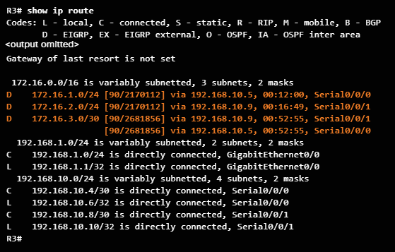
Implement EIGRP for IPv4 Verify EIGRP with IPv4
Notes:
6.2 – Implement EIGRP for IPv4
6.2.2 – Verify EIGRP with IPv4
6.2.2.3 –Verifying EIGRP: Examine the IPv4 Routing Table

Slide 52
14.6 Module Practice and Quiz
Notes:
14 - Routing Concepts
14.6 - Module Practice and Quiz

Slide 53
Module Practice and Quiz What Did I Learn In This Module?
The primary functions of a router are to determine the best path to forward packets based on the information in its routing table, and to forward packets toward their destination.
The best path in the routing table is also known as the longest match. The longest match is the route in the routing table that has the greatest number of far-left matching bits with the destination IP address of the packet.
Directly connected networks are networks that are configured on the active interfaces of a router. A directly connected network is added to the routing table when an interface is configured with an IP address and subnet mask (prefix length) and is active (up and up).
Routers learn about remote networks in two ways: static routes and with dynamic routing protocols.
After a router determines the correct path, it can forward the packet on a directly connected network, it can forward the packet to a next-hop router, or it can drop the packet.
Routers support three packet forwarding mechanisms: process switching, fast switching, and CEF.
There are several configuration and verification commands for routers, including show ip route, show ip interface, show ip interface brief and show running-config.
Notes:
14 - Routing Concepts
14.6 - Module Practice and Quiz
14.6.1 – What Did I Learn In This Module?
14.6.2 - Module Quiz - Routing Concepts

Slide 54
Module Practice and Quiz What Did I Learn In This Module? (Cont.)
A routing table contains a list of routes known networks (prefixes and prefix lengths). The source of this information is derived from directly connected networks, static routes, and dynamic routing protocols.
Every router makes its decision alone, based on the information it has in its own routing table. The information in a routing table of one router does not necessarily match the routing table of another router.
Routing information about a path does not provide return routing information.
Routing table entries include the route source, destination network, AD, metric, next-hop, route timestamp, and exit interface.
Static routes are manually configured and define an explicit path between two networking devices.
Dynamic routing protocols can discover a network, maintain routing tables, select a best path, and automatically discover a new best path if the topology changes.
The default route specifies a next-hop router to use when the routing table does not contain a specific route that matches the destination IP address. A default route can be either a static route or learned automatically from a dynamic routing protocol.
Notes:
14 - Routing Concepts
14.6 - Module Practice and Quiz
14.6.1 – What Did I Learn In This Module? (Cont.)

Slide 55
Module Practice and Quiz What Did I Learn In This Module? (Cont.)
Distance vector, link-state, and path vector routing protocols refer to the type of routing algorithm used to determine best path.
The main components of dynamic routing protocols are data structures, routing protocol messages, and algorithms.
The best path is selected by a routing protocol based on the value or metric it uses to determine the distance to reach a network. The best path to a network is the path with the lowest metric.
When a router has two or more paths to a destination with equal cost metrics, then the router forwards the packets using both paths equally. This is called equal cost load balancing.
Notes:
14 - Routing Concepts
14.6 - Module Practice and Quiz
14.6.1 – What Did I Learn In This Module? (Cont.)
14.6.2 - Module Quiz - Routing Concepts

Slide 56
Conclusion Chapter 2: EIGRP
EIGRP (Enhanced Interior Gateway Routing Protocol) is a classless, distance vector routing protocol.
EIGRP uses the source code of "D" for DUAL in the routing table. EIGRP has a default administrative distance of 90 for internal routes and 170 for routes imported from an external source, such as default routes. These features include: Diffusing Update Algorithm (DUAL), establishing neighbor adjacencies, Reliable Transport Protocol (RTP), partial and bounded updates, and equal and unequal cost load balancing.
EIGRP uses PDMs (Protocol Dependent Modules) giving it the capability to support different Layer 3 protocols including IPv4 and IPv6. EIGRP uses reliable delivery for EIGRP updates, queries and replies; and uses unreliable delivery for EIGRP Hellos and acknowledgments. Reliable RTP means an EIGRP acknowledgment must be returned.
Before any EIGRP updates are sent, a router must first discover its neighbors using EIGRP Hello packets. The Hello and hold-down values do not need to match for two routers to become neighbors. The show ip eigrp neighbors command is used to view the neighbor table and verify that EIGRP has established an adjacency with its neighbors.
Notes:
6.5 – Summary
6.5.1 – Conclusion
6.5.1.3 – Chapter 6: EIGRP

Slide 57
Conclusion Chapter 2: EIGRP (Cont.)
EIGRP sends partial or bounded updates, which include only route changes. Updates are sent only to those routers that are affected by the change. EIGRP composite metric uses bandwidth, delay, reliability, and load to determine the best path. By default only bandwidth and delay are used.
At the center of EIGRP is DUAL (Diffusing Update Algorithm). The DUAL Finite State Machine is used to determine best path and potential backup paths to every destination network. The successor is a neighboring router that is used to forward the packet using the least-cost route to the destination network. Feasible distance (FD) is the lowest calculated metric to reach the destination network through the successor. A feasible successor (FS) is a neighbor who has a loop-free backup path to the same network as the successor, and also meets the feasibility condition. The feasibility condition (FC) is met when a neighbor's reported distance (RD) to a network is less than the local router's feasible distance to the same destination network. The reported distance is simply an EIGRP neighbor's feasible distance to the destination network.
Notes:
6.4 – Summary
6.4.1 – Conclusion
6.4.1.3 – Chapter 6: EIGRP

Slide 58
Conclusion Chapter 2: EIGRP (Cont.)
EIGRP is configured with the router eigrp autonomous-system command. The autonomous-system value is actually a process-id and must be the same on all routers in the EIGRP routing domain. The network command is similar to that used with RIP. The network is the classful network address of the directly connected interfaces on the router. A wildcard mask is an optional parameter that can be used to include only specific interfaces.
EIGRP for IPv6 shares many similarities with EIGRP for IPv4. However, unlike the IPv4 network command, IPv6 is enabled on the interface using the ipv6 eigrp autonomous-system interface configuration command.
Notes:
6.4 – Summary
6.4.1 – Conclusion
6.4.1.3 – Chapter 6: EIGRP

Slide 59
Module 14: Routing Concepts New Terms and Commands
best path
longest match
prefix length
next-hop router
process switching
fast switching
Cisco Express Forwarding (CEF)
route sources
static routes
dynamic routing protocols
ip route
Default Route
ip route 0.0.0.0 0.0.0.0 [ exit-if | next-hop-ip ]
ipv6 route ::/0 [ exit-if | next-hop-ipv6 ]
Administrative Distance
RIPv2
OSPFv2
EIGRP
EIGRP for IPv6
OSPFv3
IS-IS
IS-IS for IPv6
BGP
BGP-MP
EGP
load balancing
equal-cost load balancing
unequal-cost load balancing

